Slide 1

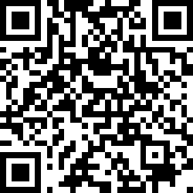
CS2113/T – Lecture 12
No pollEV session today
Examsoft briefing followed by lecture
This lecture will be recorded
This lecture will be recorded
Archipelago session

Slide 2

Recap
Architecture
Types of testing
(Unit, Integration, System, Acceptance)
Test case design
(Equivalence partitioning)

Slide 3
Today
Test case design
Other QA techniques

Slide 4
Q: (a)[3 marks] Design test cases for unit testing Parser#isValidName method.
/* Returns true if the name is non-empty and
not null and not longer than 40 chars. */
public boolean isValidName(String name) {
// ...
}
/* Throws StorageException if name is not valid
or if name already exists in the database. */
public void saveScore(String name, int score)
throws StorageException {
if (!parser.isValidName(name)) {
throw new StorageException("invalid name");
}
if (storage.isFound(name)) {
throw new StorageException("already exists");
}
storage.save(name, score);
}
(b)[2 marks] Design integration tests for the method below. Note that it uses the method given in (a)

Slide 5
/* Returns true if the name is non-empty and
not null and not longer than 40 chars. */
public boolean isValidName(String name) {
// ...
}
/* Throws StorageException if name is not valid
or if name already exists in the database. */
public void saveScore(String name, int score)
throws StorageException {
if (!parser.isValidName(name)) {
throw new StorageException("invalid name");
}
if (storage.isFound(name)) {
throw new StorageException("already exists");
}
storage.save(name, score);
}
Test input | Expected
null | false
Test input | Expected
null,0 | exception

Slide 6
Q: (a)[3 marks] Design test cases for unit testing Parser#isValidName method.
/* Returns true if the name is non-empty and
not null and not longer than 40 chars. */
public boolean isValidName(String name) {
// ...
}
Equivalence partitions
Values
null
null
empty
“ ”
too long
length = 41
, 50
right size
40, 10, 1 (perhaps?)

Slide 7
Q: (a)[3 marks] Design test cases for unit testing Parser#isValidName method.
/* Returns true if the name is non-empty and
not null and not longer than 40 chars. */
public boolean isValidName(String name) {
// ...
}
Test input | Expected
null | False
“ ” | False
Length==41 | False
Length==50 | False
Length==40 | True
Length==1 | True
Length==10 | True
Equivalence partitions
Values
null
null
empty
“ ”
too long
length = 41
, 50
right size
40, 10, 1 (perhaps?)

Slide 8
/* Throws StorageException if name is not valid
or if name already exists in the database. */
public void saveScore(String name, int score)
throws StorageException {
if (!parser.isValidName(name)) {
throw new StorageException("invalid name");
}
if (storage.isFound(name)) {
throw new StorageException("already exists");
}
storage.save(name, score);
}
(b)[2 marks] Design integration tests for the method below. Note that it uses the method given in (a)
Test input | Expected
null | False
“ ” | False
Length==41 | False
Length==50 | False
Length==40 | True
Length==1 | True
Length==10 | True
Equivalence partitions
Values
null
null
empty
“ ”
too long
length = 41
, 50
right size
40, 10, 1 (perhaps?)

Slide 9
/* Throws StorageException if name is not valid
or if name already exists in the database. */
public void saveScore(String name, int score)
throws StorageException {
if (!parser.isValidName(name)) {
throw new StorageException("invalid name");
}
if (storage.isFound(name)) {
throw new StorageException("already exists");
}
storage.save(name, score);
}
(b)[2 marks] Design integration tests for the method below. Note that it uses the method given in (a)
How do we unit test this method?
Done in isolation
If Unit testing , we should use stubs for dependencies isValidName etc.
Test input | Expected
null | False
“ ” | False
Length==41 | False
Length==50 | False
Length==40 | True
Length==1 | True
Length==10 | True
How do we integration test this method?

Slide 10
/* Throws StorageException if name is not valid
or if name already exists in the database. */
public void saveScore(String name, int score)
throws StorageException {
if (!parser.isValidName(name)) {
throw new StorageException("invalid name");
}
if (storage.isFound(name)) {
throw new StorageException("already exists");
}
storage.save(name, score);
}
(b)[2 marks] Design integration tests for the method below. Note that it uses the method given in (a)
How do we unit test this method?
If Unit testing , we should use stubs for dependencies isValidName etc.
Test input | Expected
null | False
“ ” | False
Length==41 | False
Length==50 | False
Length==40 | True
Length==1 | True
Length==10 | True
How do we integration test this method?
Integration tests are choreography tests. They do not test components. They test how well the assembly of components dance together.

Slide 11
/* Throws StorageException if name is not valid
or if name already exists in the database. */
public void saveScore(String name, int score)
throws StorageException {
if (!parser.isValidName(name)) {
throw new StorageException("invalid name");
}
if (storage.isFound(name)) {
throw new StorageException("already exists");
}
storage.save(name, score);
}
(b)[2 marks] Design integration tests for the method below. Note that it uses the method given in (a)
Eq. partitions
Values
invalid
Any invalid e.g. null
name
exists
Any existing name e.g. “existing guy”
new
Any valid new name e.g. “new guy”
score
any
any

Slide 12
/* Throws StorageException if name is not valid
or if name already exists in the database. */
public void saveScore(String name, int score)
throws StorageException {
if (!parser.isValidName(name)) {
throw new StorageException("invalid name");
}
if (storage.isFound(name)) {
throw new StorageException("already exists");
}
storage.save(name, score);
}
(b)[2 marks] Design integration tests for the method below. Note that it uses the method given in (a)
Test input | Expected
“new guy”, 0 | success
null , -3 | exception
“existing guy”, 5 | exception
Eq. partitions
Values
invalid
Any invalid e.g. null
name
exists
Any existing name e.g. “existing guy”
new
Any valid new name e.g. “new guy”
score
any
any

Slide 13


/* Throws StorageException if name is not valid
or if name already exists in the database. */
public void saveScore(String name, int score)
throws StorageException {
if (!parser.isValidName(name)) {
throw new StorageException("invalid name");
}
if (storage.isFound(name)) {
throw new StorageException("already exists");
}
storage.save(name, score);
}
(b)[2 marks] Design integration tests for the method below. Note that it uses the method given in (a)
Do we really need to test this method?
Test input | Expected
“new guy”, 0 | success
null , -3 | exception
“existing guy”, 5 | exception
Short and simple methods

Slide 14

/* Throws StorageException if name is not valid
or if name already exists in the database. */
public void saveScore(String name, int score)
throws StorageException {
if (!parser.isValidName(name)) {
throw new StorageException("invalid name");
}
if (storage.isFound(name)) {
throw new StorageException("already exists");
}
storage.save(name, score);
}
(b)[2 marks] Design integration tests for the method below. Note that it uses the method given in (a)
Do we really need to test this method?
Test input | Expected
“new guy”, 0 | success
null , -3 | exception
“existing guy”, 5 | exception

Slide 15
Quality Assurance
: Testing and Beyond

Slide 16
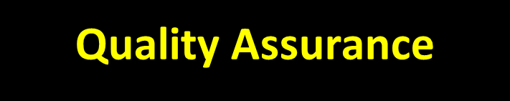

Slide 17


Slide 18
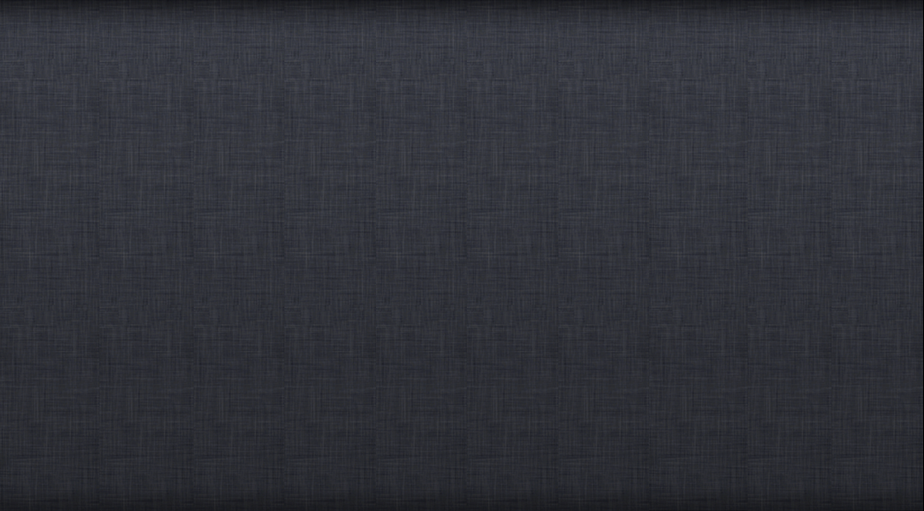
[Quality Assurance]
Validation
Verification

Slide 19
[Quality Assurance]
Validation
Verification
Are we building the correct product?
Are we building the product correctly?

Slide 20
[Quality Assurance]
Validation
Verification
Are we building the correct product?
Are we building the product correctly?

Slide 21
[Quality Assurance]
Validation
Verification
Are we building the correct product?
Are we building the product correctly?
FAIL!

Slide 22
[Quality Assurance]
Validation
Verification
Are we building the correct product?
Are we building the product correctly?
FAIL!
FAIL!

Slide 23
[Quality Assurance]
Validation
Other QA techniques
Verification
Code reviews • static analysis • formal methods• …
Acceptance testing

Slide 24



[Quality Assurance]
Validation
Other QA techniques
Verification
Code reviews • static analysis • formal methods • …
Acceptance testing

Slide 26
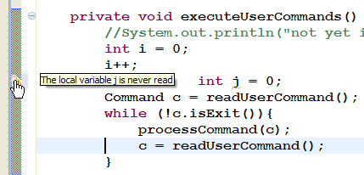
CheckStyle

Slide 27
[Quality Assurance]
Validation
Other QA techniques
Verification
Code reviews • static analysis • formal methods• …
Acceptance testing
SUT
doubleAmount(int):int

Slide 28
[Quality Assurance]
Validation
Other QA techniques
Verification
Code reviews • static analysis • formal methods• …
Acceptance testing
Text case 1:
Input: 23
Expected output: 46
Text case 2:
Input: 10
Expected output : 20
Text case n:
Input: -2
Expected output : -4
…
SUT
doubleAmount(int):int
Testing

Slide 29
[Quality Assurance]
Validation
Other QA techniques
Verification
Code reviews • static analysis • formal methods• …
Acceptance testing
Text case 1:
Input: 23
Expected output: 46
Text case 2:
Input: 10
Expected output : 20
Text case n:
Input: -2
Expected output : -4
…
Mathematically prove if input = x
then, output = 2x
SUT
doubleAmount(int):int
Testing

Slide 31
Exam format
Types of questions:
T/F & MCQ
Short answers
Using Examplify
Duration: 90 min
One ungraded question to specify the assumptions made, if any.
Write NA if you don’t use it

Slide 32
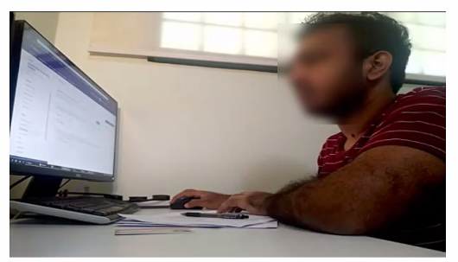
CS2113/T PE Instructions
Your camera setup should look like the image alongside
Place your phone in Landscape mode
Connect to Zoom via PC (for us to communicate with you) and Phone (for the video feed)
Rename the PC Zoom session to be [PC] Student Name and the phone session to be Student Name
Respond to invigilators’ communication via PC Zoom session
Turn off the video feed from your PC Zoom session.
Only one video feed per student, from the phone.
Do not use virtual backgrounds

Slide 33
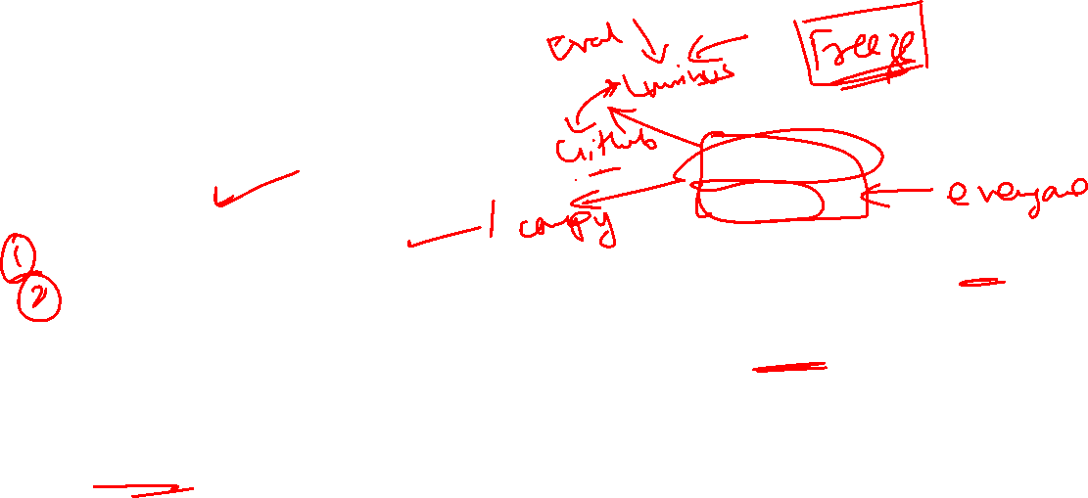
tP – last hurdle! Submissions
So far, good job everyone!
Hardest part remains
Submissions
Evaluating your own team
Evaluating other teams
PE – Testing
PE – Bug processing
We will switch to summative assessment
Deadlines are strict – there will be penalty for non conformance and late submissions
Product JAR
UG/DG/PPP
Demo video
Peer evaluation (Teammates)
PE – overall evaluation (Teammates)

Slide 34
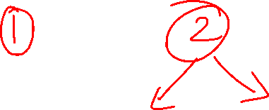
End semester feedback session
Please provide your feedback
Separate out the concerns – Module vs Teaching team

